Slide 1
An Example of Referential Integrity
Only students listed in the Students relation should be allowed to enroll for courses.
Enrolled
Students
sid | cid | grade
53666 | Carnatic101 | C
53666 | Reggae203 | B
53650 | Topology112 | A
53666 | History105 | B
sid | name | login | age | gpa
53666 | Jones | jones@cs | 18 | 3.4
53688 | Smith | smith@eecs | 18 | 3.2
53650 | Smith | smith@math | 19 | 3.8
Principles of Database Systems, Xu Lizhen
Notes:
7

Slide 2
Other Integrity Constraints
Domain integrity constraint
  An attribute’s value must be a value in the domain of this attribute. This is the most basic constraint. All popular RDBMS are able to check domain integrity constraint automatically.
Entity integrity constraint
  Every relation should have a primary key. The value of primary key of each tuple must be unique. Primary key cannot be NULL. This is so-called entity integrity constraint.
Principles of Database Systems, Xu Lizhen

Slide 3
Example Instances
“Sailors”, “Reserves” and “Boats” relations for our examples.
R1
sid | bid | day
22 | 101 | 10/10/96
58 | 103 | 11/12/96
B1
bid | bname | color
101 | tiger | red
103 | lion | green
105 | hero | blue
S1
S2
sid | sname | rating | age
22 | dustin | 7 | 45.0
31 | lubber | 8 | 55.5
58 | rusty | 10 | 35.0
sid | sname | rating | age
28 | yuppy | 9 | 35.0
31 | lubber | 8 | 55.5
44 | guppy | 5 | 35.0
58 | rusty | 10 | 35.0
Principles of Database Systems, Xu Lizhen
Notes:
5

Slide 4
Relational Algebra
Basic operations:
  Selection (σ) Selects a subset of rows from relation.
  Projection (π) Deletes unwanted columns from relation.
  Cross-product (×) Allows us to combine two relations.
  Set-difference (−) Tuples in reln. 1, but not in reln. 2.
  Union (∪) Tuples in reln. 1 and in reln. 2.
{σ, π, ∪, −, ×} is a complete operation set. Any other relational algebra operations can be derived from them.
Additional operations:
  Intersection, join, division, outer join, outer union: Not essential, but (very!) useful.
Since each operation returns a relation, operations can be composed! (Algebra is “closed”.)
Principles of Database Systems, Xu Lizhen
Notes:
6

Slide 5
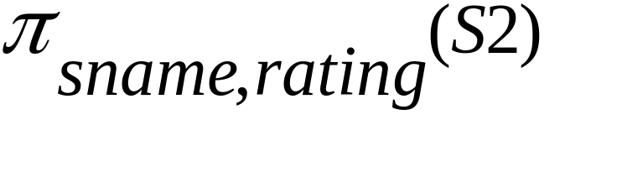
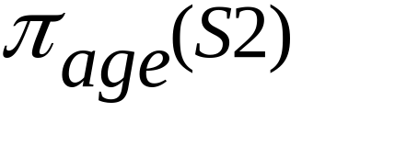
Projection
Deletes attributes that are not in projection list.
Schema of result contains exactly the fields in the projection list, with the same names that they had in the input relation.
Projection operator has to eliminate duplicates! (Why??)
  Note: real systems typically don’t do duplicate elimination unless the user explicitly asks for it. (Why not?)
sname | rating
yuppy | 9
lubber | 8
guppy | 5
rusty | 10
age
35.0
55.5
Principles of Database Systems, Xu Lizhen
Notes:
7

Slide 6
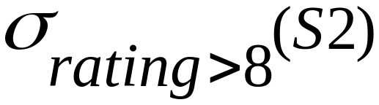
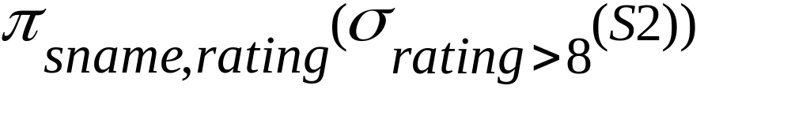
Selection
Selects rows that satisfy selection condition.
No duplicates in result! (Why?)
Schema of result identical to that of input relation.
Result relation can be the input for another relational algebra operation! (Operator composition.)
sid | sname | rating | age
28 | yuppy | 9 | 35.0
58 | rusty | 10 | 35.0
sname | rating
yuppy | 9
rusty | 10
Principles of Database Systems, Xu Lizhen
Notes:
8

Slide 7
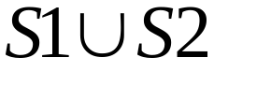

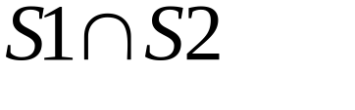
Union, Intersection, Set-Difference
All of these operations take two input relations, which must be union-compatible:
  Same number of fields.
  Corresponding attributes have the same type.
What is the schema of result?
sid | sname | rating | age
22 | dustin | 7 | 45.0
31 | lubber | 8 | 55.5
58 | rusty | 10 | 35.0
44 | guppy | 5 | 35.0
28 | yuppy | 9 | 35.0
sid | sname | rating | age
22 | dustin | 7 | 45.0
sid | sname | rating | age
31 | lubber | 8 | 55.5
58 | rusty | 10 | 35.0
Principles of Database Systems, Xu Lizhen
Notes:
9

